Slide 1
Object Basics
A First Look

Slide 2
Before Objects
Procedural Languages
Popular Paradigm
Imperative Programming
Sequence of steps used to solve problem
Structured Programming
View solution as a set of procedures
Procedures and data interwoven in the application

Slide 3
Procedural program
int[] scores = getScoresFromFile();
int lowestScore = scores[0];
for (int i = 1; i < scores.length; i++)
if (scores[i] < lowestScore)
lowestScore = scores[i];
print(lowestScore);

Slide 4

Breaking down a task (Sequence)
Feed the Dog
Find dog food
Get dog food
Open dog food
Get bowl
Fill bowl
Give dog the bowl

Slide 5
Breaking down a task
Show average grade for an assignment
Create variable to hold the total of all grades.
Create a variable to track the count of grades.
Get all grades and place in variable to hold them.
Cycle through each grade in list.
Add grade to total grades.
Increment the counter by one.
Stop cycling through each grade.
Create a variable to hold the average grade.
Divide the total by the count of grades and store it in the variable.
Print the average grade variable.

Slide 6
Breaking down a task (Short version)
Show average grade for an assignment
Create variable to hold the total of all grades.
Put the grades in a list
For each grade in the list, add grade to total grades.
Print the grades total divided by the length of the list.
double[] grades = getGrades();
double total = 0.0;
foreach (double g in grades)
total += g;
Console.Write(total/grades.Count);

Slide 7
Structure Chart (Find Lowest Grade)
GetAverageGrade
Maintenance can be difficult and time consuming
Changes made in upper hierarchy layers can cascade down to lower levels
GetGrades
CalculateTotal
CalculateAverage
Print

Slide 8
Object Oriented Programming
AKA OOP
Characterized by A-PIE
Abstraction
Polymorphism
Inheritance
Encapsulation
Tries to model the data not the process
Notes:
Object Oriented Programming is a programming language paradigm that builds upon structured programming in procedural programming languages with the concept that procedures and the data on which they operate can be viewed as two parts of the same thing: an object.
An object-oriented programming language is generally characterized by four distinguishing features – abstraction, polymorphism, inheritance, and encapsulation (sometimes referred to collectively as A-PIE).
•abstraction: ignoring irrelevant features, properties, or functions and emphasizing those that are relevant to the given project.
•encapsulation: the act of grouping into a single object both data and the operations that affect that data.
•inheritance: the process of creating new classes from existing classes.
•polymorphism: the ability to perform the same operation on different types of objects, each one implementing that operation in a way appropriate to them.
Object-oriented designs are better able to more accurately model the real world than procedural languages.
•Instead of viewing the world as a set of processes, it instead views the world as a collection of entities that are characterized by certain behaviors.
•Furthermore, objected-oriented languages make it easier to create new data types to better represent real-world objects.
The fundamental idea behind object-oriented languages is to combine both data and the functions that operate on that data into a single unit called an object.
•An object's functions, referred to as methods, provide the only way to access its data.
•In OO terminology, methods are also referred to as behaviors.
•In order to read a data item in an object, one of the object's methods must be called to read the data item and return its value.
•The data cannot be accessed directly.
•It is hidden, and is safe from accidental alteration.
•Data and functions are said to be encapsulated into a single entity.
Both data encapsulation and data hiding are key concepts in the object-oriented paradigm.
The restriction of allowing only an object's methods to change that object's data insures that nothing else can alter that data, and therefore simplifies writing, debugging, and maintaining the program.

Slide 9
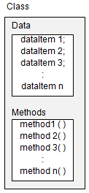
OOP Paradigm
Objects represent real world
Classes define
View data and procedures as 2 parts of the same object (or thing)
Data and procedures are encapsulated in one place
Data can be protected
Implementation details are hidden from the application
Notes:
Objects
An object is a computer representation of some real-world thing or event.
Example: if you own a Jeep, you might know several of its characteristics, such as the name of the model (Jeep Wrangler), the vehicle ID number (#51Y62BG826341Y), and the motor type (6Â­Cyl).
Objects have both attributes (such as the model, VIN, and motor type) and behaviors (such as "lights go on" and "lights go off").

Slide 10
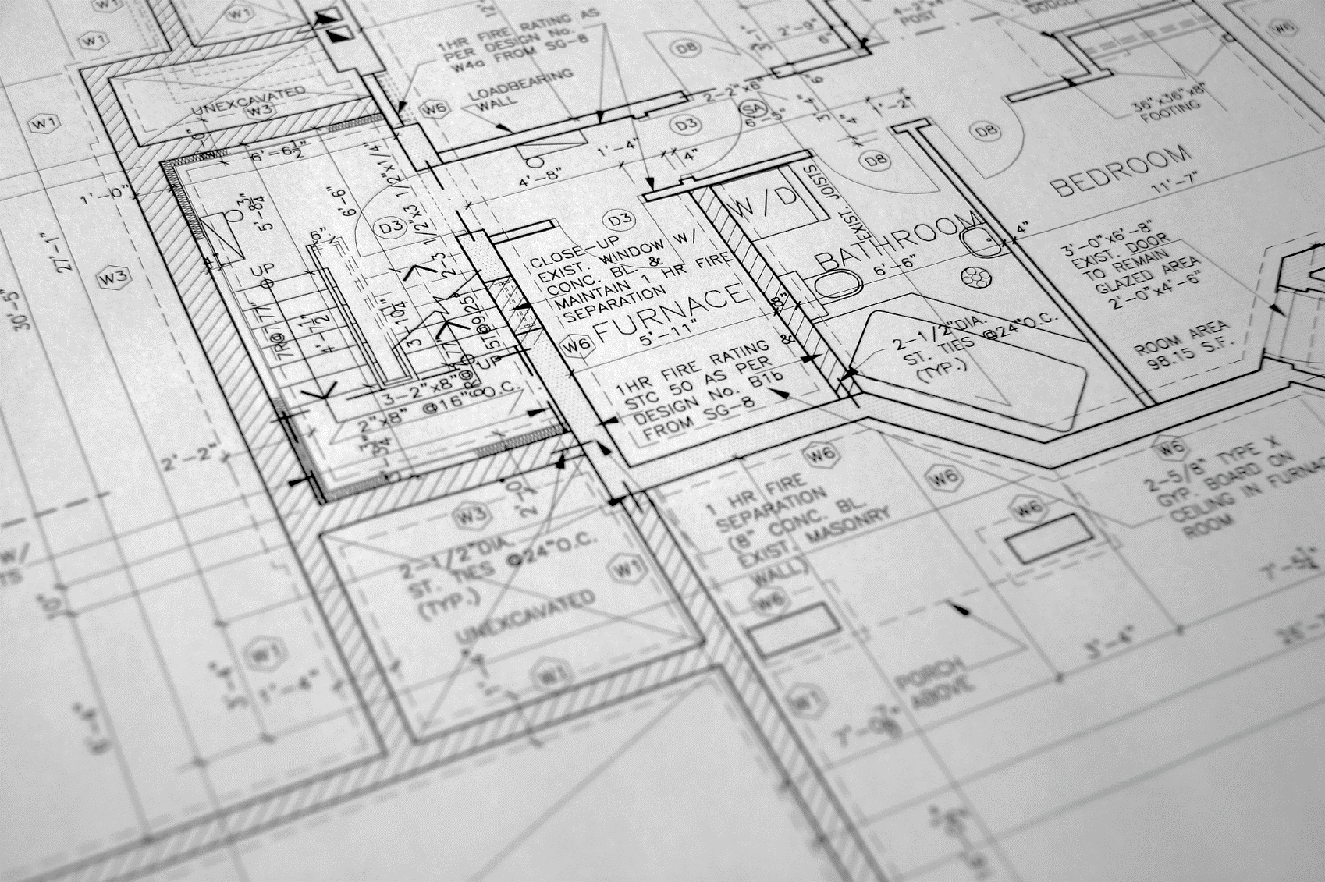
Classes
Define objects
Common structure
Act as plan, blueprint, structure, guideline
Attributes
Behaviors
Theoretical
Only in code
Not the thing
Custom DataType
int, double, float, Scanner
Student, Course, Professor
Notes:
Classes
A class is a category of similar objects.
A class defines the set of shared attributes and behaviors found in each object in the class.
Objects are grouped into classes.
Example: a group of objects representing automobiles might be formed into a class called "Automobile." Every automobile will have values for the attributes Make/Model, VIN, and Engine.
The data components of a class are called instance variables.
Classes must be defined by the programmer. When the program runs, objects can be created from the established class.
The term instantiation is used when an object is created from a class.
For example, a program could instantiate the Jeep Wrangler as an object from the class Automobile.
Just as an instance of a primitive type is called a variable, an instance of a class is called an object.
There may be many objects of a class, just as there may be many variables of a primitive data type.
Placing data and functions together into a single entity is the central idea of object-oriented programming.

Slide 11
Class Diagram
Student
Course
EnrolledCourse
Each class has its own data and services. Examples
Student
Student number, name, address, etc.
Ability to get contact info, personal data
Course
Course number, location, and maximum number of seats
Ability to find teaching load
EnrolledClass
Students, Professor
Ability to add students, and retrieve student lists

Slide 12
Literary References
Object
Function / Sub
Property / Field
=
=
=
Noun
Verb
Adjective

Slide 13
Defining OOP
You need to make a program that keeps track of students. We will need to keep track of their name, class level, phone number, address, and age.
students
name
class level
phone number
address
age
public class Student{
public String name;
public String classLevel;
public long phoneNumber;
public int age;
}

Slide 14
Defining an Class
public class Student{
private String _name;
private int _ID;
private String _address;
private double _maximumCredits;
public String getName() {};
public void setName(String value) {};
public boolean isEnrolled() {};
}

Slide 15
Instantiation
Class is used
Build object in memory
Stack
Heap
Notes:
Instances
An object has the same relationship to a class that a variable has to a data type.
An object is said to be an instance of a class

Slide 16

Sugar Cookie Metaphor
How do you make sugar cookies?
How are cookies different?

Slide 17

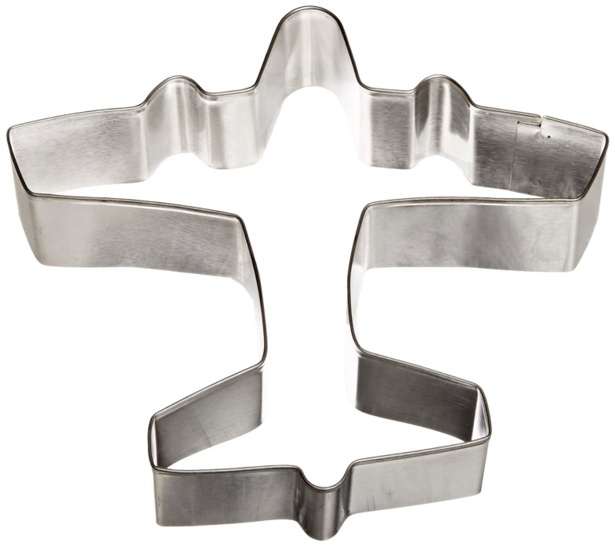

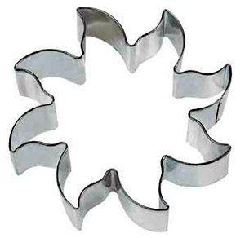
Classes are Blueprints or Cookie Cutters

Slide 18
Plane Object
public class Plane {
public String Color;
public String Name;
public int PassengerLoad;
public double WingSpan;
public boolean IsBiWing;
public boolean Running;
public void TakeOff() {};
public void TurnLeft() {};
public void TurnRight() {};
public boolean AmIRunning() {};
}
Adjectives
Noun
Verbs

Slide 19
The Heap
Dough

Slide 20
Instantiation
Dough
Cookie Cutter

Slide 21
The Cookies

Slide 22
Each is a Cookie

Slide 23
Can have different Attributes

Slide 24
Defining an Object
public class Rectangle {
private int _height;
private int _width;
public Rectangle(){
}
public Rectangle(int newHeight, int newWidth){
_height = newHeight;
_width = newWidth;
}
public int height(){ return _height;}
public int width(){ return _width;}
public void setHeight(int value){ _height = value;}
public void setWidth(int value){ _width = value;}
public double getArea(){return _height * _width;}
}
Fields
Constructors
Overloaded Constructor
Accessors
Mutators
Member Method

Slide 25
Example

Slide 26
Four Major OOP Concepts
Abstraction
Encapsulation
Inheritance
Polymorphism

Slide 27
Abstraction
Hiding of complexity
From the end User
From other developers
Design technique
Allows programmer to focus on the what is needed
Not how it is implemented
Attributes (variables)
Behaviors (methods)

Slide 28

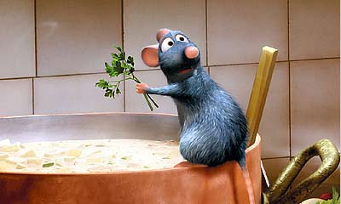
Abstraction Example
Restaurant
Have no idea how your food is:
Prepared
Made

Slide 29
Encapsulation
Separation / Segregation of code
Place all data and services of an object in one place
Control access to the data
Data is reliable
Data is consistent
Easier to maintain code - can change one part without affecting other parts of the application
Allows programmer to view object as a black box
Input
Data
Object
Output
“Information”

Slide 30
Inheritance
Sharing of attributes and behaviors
Create a new class from existing class
Allow reuse of reliable code
Student is the base class
ForeignStudent is derived from base class
ForeignStudent can use data and behaviors of student and create new data and behaviors for foreign students (e.g. visa data)
Student
ForeignStudent

Slide 31
Polymorphism
Allows performing the same operation on two different objects. Operation is performed differently on each object
SetPhone operation is performed in Student using U.S. style phone format
SetPhone operation has same name for foreign students but sets the phone number using international phone number format
Student
ForeignStudent

Slide 32
Class Data
Instance Data
Private Instance Variables
Public methods to access data
Accessors
Mutators
Properties in Visual Studio languages
Data Hiding
Control access to hidden instance variables
Insures that data is reliable and consistent

Slide 33
Access Modifiers
Class can deny or provide access to members outside the class by using access modifiers
private or no modifier: Only members inside the class can directly access the member
internal: Only members in the assembly (namespace) can directly access the member (normally used in .dll assemblies)
protected: Only members in the class or derived (child) classes can directly access the member
public: Member can be accessed from both inside and outside the class
NOTE: A class with no modifier is internal by default

Slide 34
Access Modifiers Relative to Employee Class
Public
Namespace
Internal
Boss
Employee
Employer
Customer
Private
Protected
Company

Slide 35
Class Initialization
Constructors
Public Methods used by class developer for initialization
Called automatically when object of class type is created
Cannot return a value
Default constructor
Has no parameters
Created automatically by the compiler
Overloaded constructor
Has one or more parameters
Used to initialize instance data

Slide 36
Class Behavior
Methods (member functions in some languages)
Provide the behavior of the class
Hide implementation details from application programmer
Messages
Communication between classes is performed by passing messages
A method call is a message to a class to execute the code in a method
Data can be passed as arguments in the messages

Slide 37
Objects
A class is a data type: it cannot be used until an instance of the class is created.
The class instance is called an object
The process of creating the object is called instantiation
A program can create as many instances of a class as needed. Each instance is a separate object with its own instance data and methods
Objects are created on the heap* and the object variable is a reference variable (refers to the address of the object)

